Slide 1
Highways / OIT Partnership
Partnership
KYTC OIT Guiding Principles
Overview of TED and the KYTC Project Management System
Highways Application Modernization
Current Development efforts
Notes:
Thank you for allowing the time to present. Wanting to communicate some tools and get your thoughts on current and future developments.
Presentation will cover the following topics:
Available Tools
KYTC OIT Guiding Principles
Overview of TED and the KYTC Project Management System
Current Development
Introduce OIT Staff that will also be speaking: Kim Wells, Kim Monroe, Steve McNabb, and Jonathan Cordier

Slide 2
KYTC Office of Information Technology Application Development Project Management Process
Guiding Principles for KYTC OIT Projects
Collaborate & partner with the business areas on all IT Initiatives, including districts
Identify and engage key stakeholders
Enable employees to work more efficiently
Eliminate duplicative collection and entry of data
Minimize paper processing
Support data driven decision making
Don’t leave data behind, always migrate
Maintain consistency of data entry
Embed the system within the process to promote system utilization
Maintain consistent spatial data for improved integration
Be adaptable to changing technology and business needs
Notes:
Kim Wells and Team.

Slide 3
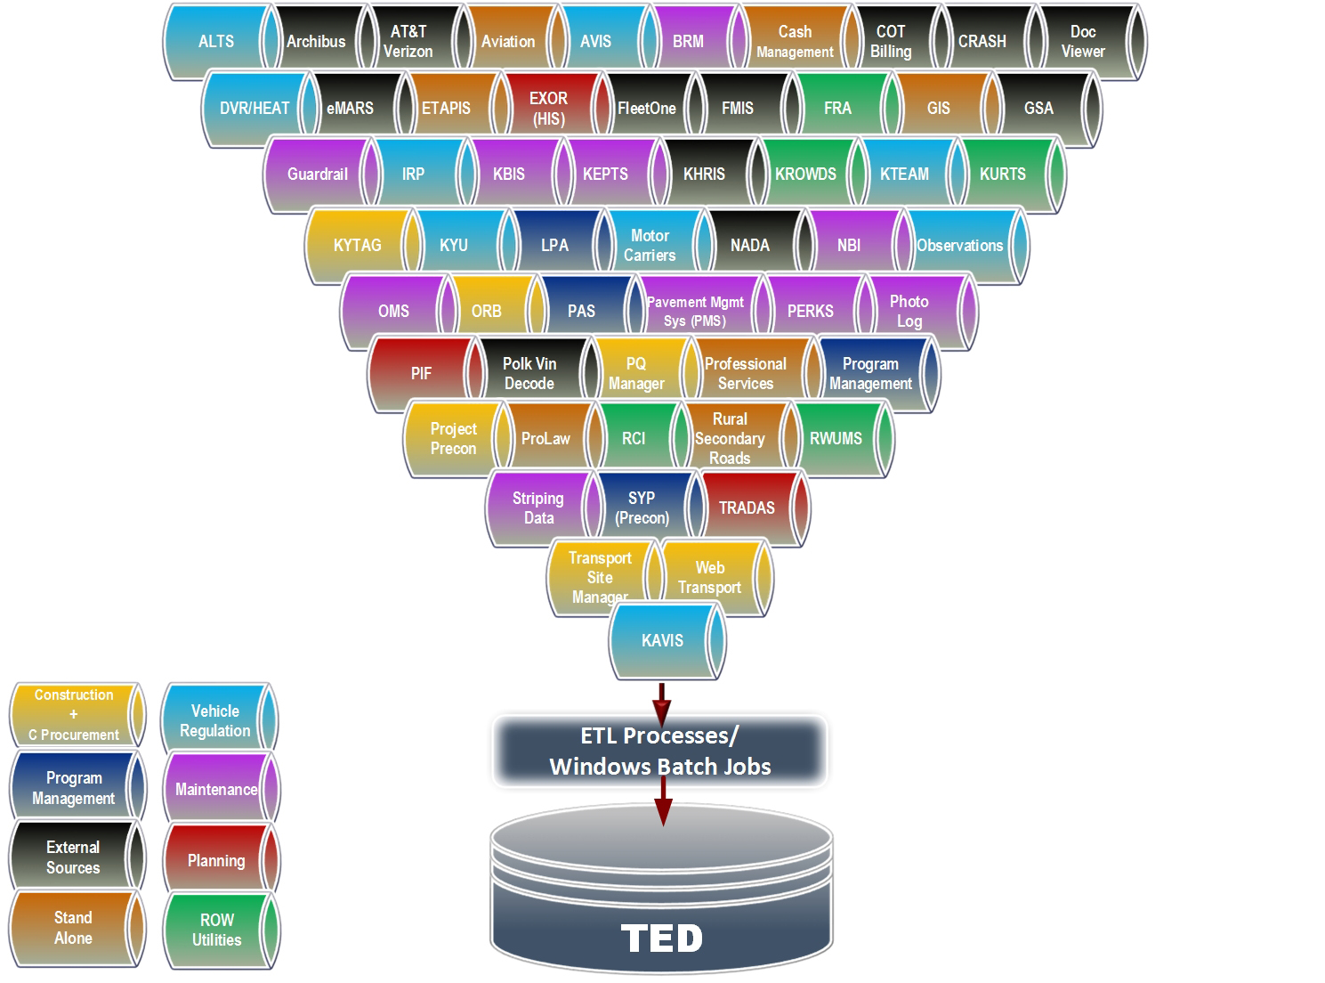
KYTC Office of Information Technology Transportation Enterprise Database Warehouse & Project Management System
Notes:
The Transportation Enterprise Data-warehouse contains over 50 data sets collected from unique KYTC applications. Roughly 50% of these data sets are related to the pre-construction highway project delivery process (including the AASHTO precon letting data). We have also organized the Construction data (Site-Manager).
The Enterprise Data Services Branch in OIT makes every effort to combine related databases to provide a complete and comprehensive view of each project, as well as program analysis capability. Our goal is to provide a seamless cradle to grave data view of each project.
In the past, we recognize that our application development efforts have been too limited to the needs of the requesting business area. We now are seeking out ALL stake-holders that will be affected by an application development effort.

Slide 4
KYTC Office of Information Technology Transportation Enterprise Database Warehouse & Project Management System
Notes:
Moving forward…
OIT is working on a new TEDii project that will be focused on more “real-time” data availability as well as much improved information access to all project development data, as well as all other KYTC datasets. This project is a fully funded capital project that will begin within the next few weeks. We will likely be inquiring with some of the folks in this room to help better understand your data related needs.
… Our highways application development efforts will be greatly unified by the development of our highways “CORE” database. We will identify and share the “authoritative” data source across applications.
Data will be shared… and not re-entered.

Slide 5
Office of Information Technology Project Prioritization
OIT Prioritization Criteria
Strategic Alignment – Weight 65%
Meets KYTC Strategic Goals
Legislative / Legal Compliance
Technical Requirement
Cabinet Leadership Vision
Convenience / Improvement
Direct impact or use by majority of citizens
Improves or provides service to substantial business or citizens
Provides an external facing customer service
Improves internal process that serve a large employee base
Improves internal process
Risk Avoidance for KYTC
Reduce Technical Debt
Business Value – Weight 25%
Will the project eliminate or significantly reduce expenditures?
Will the project generate revenue?
Will the projects save time / resource hours
Funding – 10%
Is the project fully funded? (Capital project, business unit funding)
Is the project partially funded (grants, etc.)?
Notes:
Kim Wells and Team

Slide 6
Current Development
Working Phase
SYP Data System – CHAF Project (CHAF – Continuous Highways Analysis Framework)
SYP Data System – Funding Authorization (All Phases)
KEPT Release 3
eConstruction Change Orders
KROWDS – Appraisals
ROW Status Report
PreCon Status Report Revisions (add KURTS data)
Requested
KYTAG Rewrite
KQTL Rewrite
Division of Planning Project Tracking Workflow
ClearView Rewrite
Professional Services Release 2
Consultant Evaluation System
Division of Maintenance Estimator
RCI Data Upgrade
Notes:
Kim Wells and Team

